Slide 1
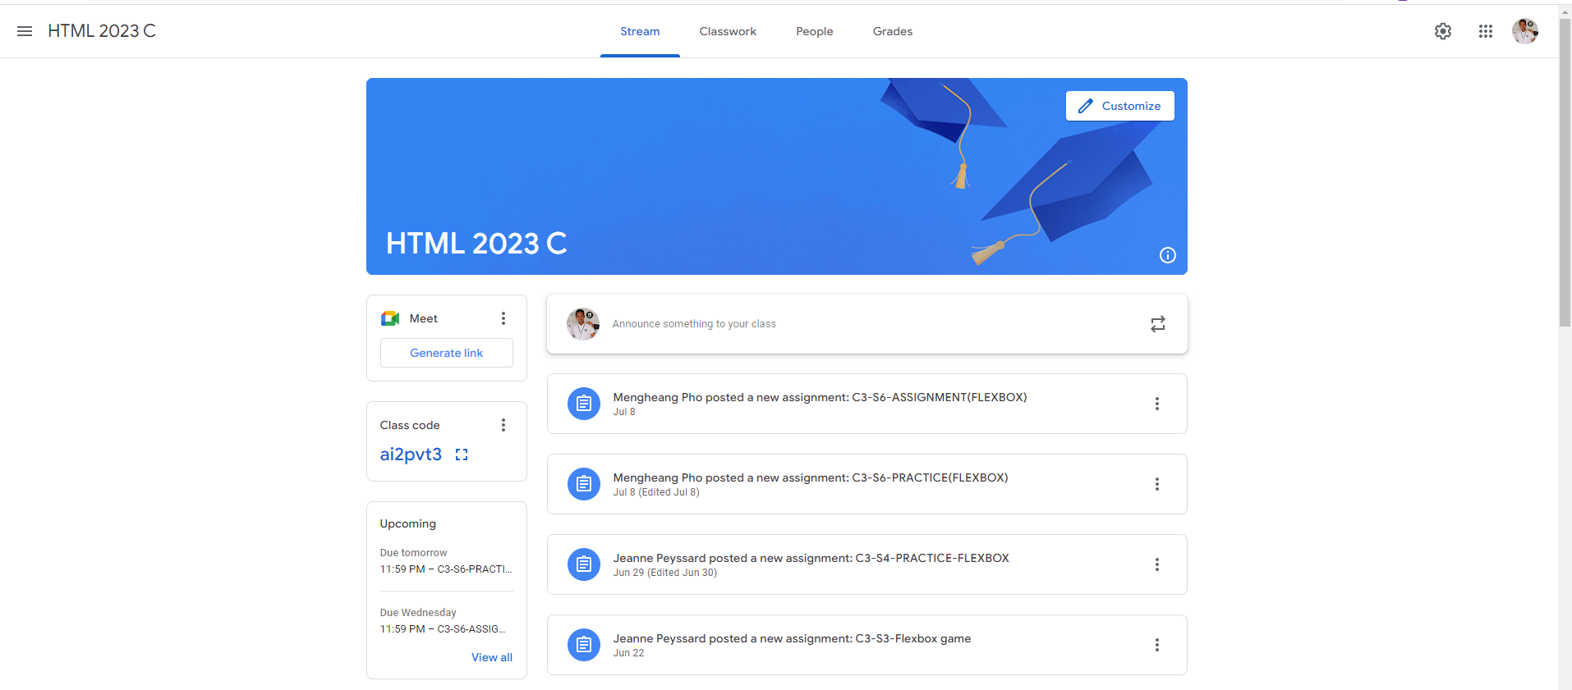
Identify root components of website below

Slide 2
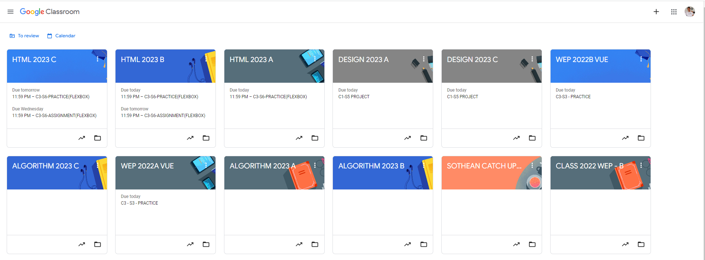
Root div
- Height: 100vh
content
nav
Flex: 0
header
Flex: 0
Flex: 1

Slide 3
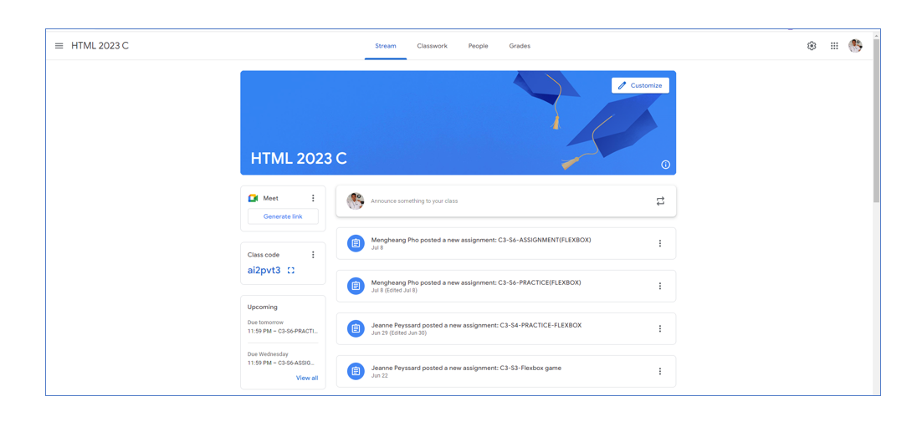
Main Containers
Header
flex 0
Body
Flex 1
Flex-direction: column;

Slide 4
Header
Left nav
Center nav
Right nav
Flex-direction: row;
Justify-content: space between;

Slide 5
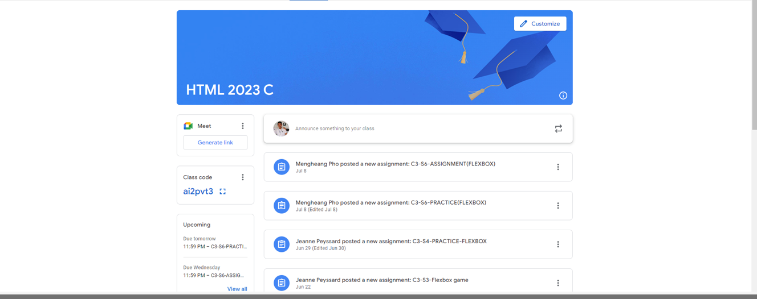
Body
Class
Contents
Flex-direction: column;
Align-Content: center;

Slide 6
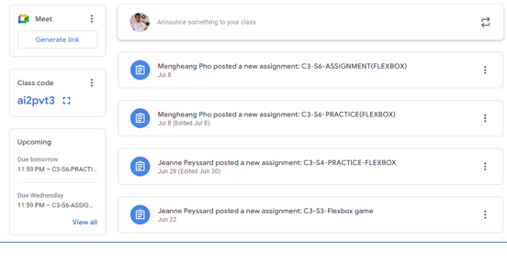
Sidebar
Flex 0;
Class contents
Flex 1;
flex-direction: row;

Slide 7
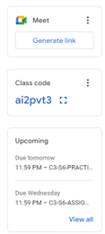
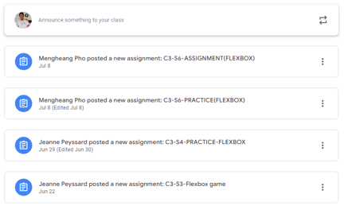
SideBar
Class contents
flex-direction: column;
flex-direction: column;

Slide 8

Class contents
Doc icon
Content title
Ellipsis icon
flex-direction: row;

